Slide 1
Beyond NoSQL

Slide 2
Objectives
File Systems
Event Sourcing
Memory Image
Version Control
XML Databases
Object Databases

Slide 3
File Systems
Databases are very common, but file systems are almost everywhere.
It is widely used for personal productivity documents, but not for enterprise applications.
They don’t advertise any internal structure, so they are more like key-value stores with a hierarchic key.
They also provide little control over concurrency other than simple file locking which itself is similar to the way NoSQL only provides locking within a single aggregate.

Slide 4
It is simple and widely implemented.
They cope well with very large entities, such as video and audio.
Often, databases are used to index media assets stored in files.
Files also work very well for sequential access, such as streaming, which can be handy for data which is append-only.
Technologies like the Google File System and Hadoop provide support for replication of files.
Much of the discussion of map-reduce is about manipulating large files on cluster systems, with tools for automatic splitting of large files into segments to be processed on multiple nodes.
Common entry path into NoSQL is from organizations that have been using Hadoop.

Slide 5
File systems work best for a relatively small number of large files that can be processed in big chunks, preferably in a streaming style.
Large numbers of small files generally perform badly this is where a data store becomes more efficient.
Files also provide no support for queries without additional indexing tools such as Solr

Slide 6
Event Sourcing
Event sourcing is an approach to persistence that concentrates on persisting all the changes to a persistent state, rather than persisting the current application state itself.
it’s an architectural pattern that works quite well with most persistence technologies, including relational databases.
i.e. system that keeps a log of the location of ships.
It has a simple ship record that keeps the name of the ship and its current location.
When we hear that the ship King Roy has arrived in San Francisco, we change the value of King Roy’s location field to San Francisco.
Later on, we hear it’s departed, so we change it to at sea, changing it again once we know it’s arrived in Hong Kong.

Slide 7
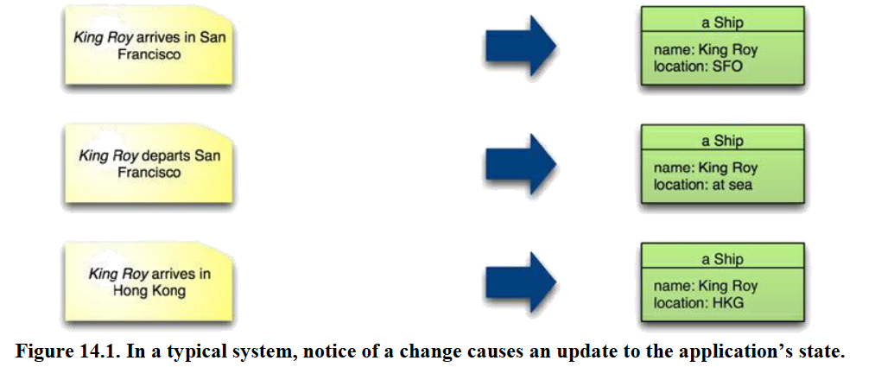

Slide 8
With an event-sourced system, the first step is to construct an event object that captures the information about the change.
This event object is stored in a durable event log.
Finally, we process the event in order to update the application’s state.

Slide 9
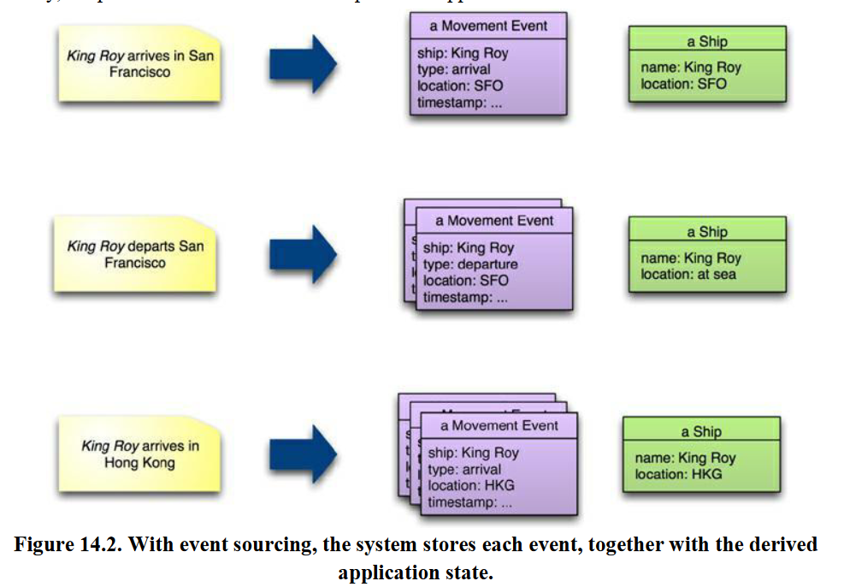

Slide 10
In event-sourced system we store every event that’s caused a state change of the system in the event log, and the application’s state is entirely derivable from this event log.
At any time, we can safely throw away the application state and rebuild it from the event log.
Event logs are all you need because you can always recreate the application state whenever you need it by replaying the event log.
In practice, this may be too slow. As a result, it’s usually best to provide the ability to store and recreate the application state in a snapshot.
Snapshot is designed to persist the memory image optimized for rapid recovery of the state.

Slide 11
snapshot
How frequently you take a snapshot depends on your uptime needs.
The snapshot doesn’t need to be completely up to date
as you can rebuild memory by loading the latest snapshot and then replaying all events processed since that snapshot was taken.
An example approach would be to take a snapshot every night; should the system go down during the day, you’d reload last night’s snapshot followed by today’s events.
If you can do that quickly enough, all will be fine.

Slide 12
To get a full record of every change in your application state, you need to keep the event log going back to the beginning of time for your application.
But in many cases such a long-lived record isn’t necessary, as you can fold older events into a snapshot and only use the event log after the date of the snapshot.
Using event sourcing has a number of advantages. You can broadcast events to multiple systems, each of which can build a different application state for different purposes.

Slide 13
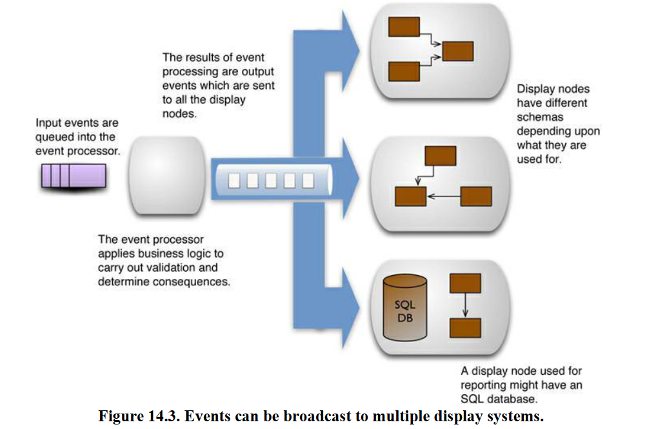

Slide 14
Event sourcing is also an effective platform for analyzing historic information, since you can replicate any past state in the event log.
You can also easily investigate alternative scenarios by introducing hypothetical events into an analysis processor.
Event sourcing does add some complexity most notably, you have to ensure that all state changes are captured and stored as events.
Some architectures and tools can make that inconvenient.
Any collaboration with external systems needs to take the event sourcing into account; you’ll need to be careful of external side effects when replaying events to rebuild an application state.

Slide 15
Memory Image
One the consequences of event sourcing is that the event log becomes the definitive persistent record but it is not necessary for the application state to be persistent.
This opens up the option of keeping the application state in memory using only in-memory data structures.
Keeping all your working data in memory provides a performance advantage, since there’s no disk I/O to deal with when an event is processed.
It also simplifies programming since there is no need to perform mapping between disk and in-memory data structures.

Slide 16
Memory Image
The obvious limitation here is that you must be able to store all the data you’ll need to access in memory.
This is an increasingly viable option—we can remember disk sizes that were considerably less than the current memory sizes.
You also need to ensure that you can recover quickly enough from a system crash—either by reloading events from the event log or by running a duplicate system and cutting over.
You’ll need some explicit mechanism to deal with concurrency.
Breaking the separation between in-memory and persistent data also affects how you handle errors.
A common approach is to update a model and roll back any changes should an error occur.
With a memory image, you’ll usually not have an automated rollback facility; you either have to write your own (complicated) or ensure that you do thorough validation before you begin to apply any changes.

Slide 17
Version Control
Version control allows many people on a team to coordinate their modifications of a complex interconnected system, with the ability to explore past states of that system and alternative realities through branching.
Version control systems are built on top of file systems, and thus have many of the same limitations for data storage as a file system.
They are not designed for application data storage, so are awkward to use in that context.
However, they are worth considering for scenarios where their timeline capabilities are useful.

Slide 18
XML Databases
Flurry of interest in databases specifically designed to store and query XML documents.
XML databases as document databases where the documents are stored in a data model compatible with XML, and where various XML technologies are used to manipulate the document.
Use XML schema definitions to check document formats, run queries with Xpath and XQuery, and perform transformations with XSLT.
Relational databases took on XML and blended these XML capabilities with relational ones, usually by embedding XML documents as a column type and allowing some way to blend SQL and XML query languages.

Slide 19
XML Databases
There’s no reason why you can’t use XML as a structuring mechanism within a key-value store.
XML is less fashionable these days than JSON, but is equally capable of storing complex aggregates, and XML’s schema and query capabilities are greater than what you can typically get for JSON.
Using an XML database means that the database itself is able to take advantage of the XML structure and not just treat the value as a blob, but that advantage needs to be weighed with the other database characteristics.

Slide 20
Object Databases
When object-oriented programming started its rise in popularity, there was a flurry of interest in object-oriented databases.
The focus here was the complexity of mapping from in-memory data structures to relational tables.
The idea of an object-oriented database is that you avoid this complexity—the database would automatically manage the storage of in-memory structures onto disk. You could think of it as a persistent virtual memory system, allowing you to program with persistence yet without taking any notice of a database at all.

Slide 21
Object databases didn’t take off.
One reason was that the benefit of the close integration with the application meant you couldn’t easily access data other than with that application.
A shift from integration databases to application databases could well make object databases more viable in the future.
An important issue with object databases is how to deal with migration as the data structures change.
Here, the close linkage between the persistent storage and in-memory structures can become a problem.
Some object databases include the ability to add migration functions to object definitions.

